Slide 1
Deep Sentiment Classiﬁcation and Topic Discovery on Novel Coronavirus or COVID-19 Online Discussions: NLP Using LSTM Recurrent Neural Network Approach
Individual Task - 2 Group - 5 Submitted By - Shouri Saha 20101349
Section - 1
Submitted To - Annajiat Alim Rasel
RA: Mehnaz & Sabbir

Slide 2

INTRODUCTION MOTIVATION/PURPOSE CONTRIBUTION
METHODOLOGIES AND EXPERIMENTS RESULT
LIMITATIONS FUTURE WORK CONCLUSION

Slide 3

Introduction
The emergence of the new coronavirus (COVID- 19) has incited widespread internet discourse. This lecture examines the application of LSTM recurrent neural networks for sentiment analysis and subject identiﬁcation in talks, utilizing natural language processing (NLP) methodologies. In this research, we explore the acquired insights and their corresponding ramiﬁcations.

Slide 4
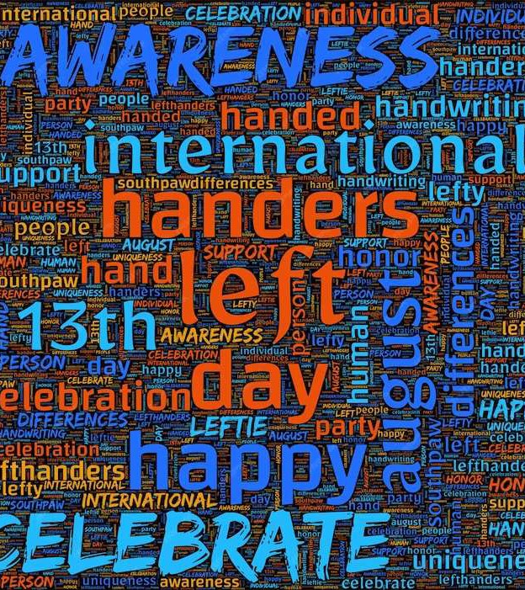
Motivation
Understanding public sentiment and topics related to COVID-19. Leveraging NLP for sentiment analysis and topic discovery.
Informing public health decision- making.
Contributing to the ﬁeld of NLP and public health research

Slide 5
Contribution
Proposing a novel deep learning approach.
Achieving high accuracy( 81.15% ) in sentiment classiﬁcation. Identifying key topics in COVID-19 discussions.
Demonstrating the applicability of NLP in public health research.

Slide 6
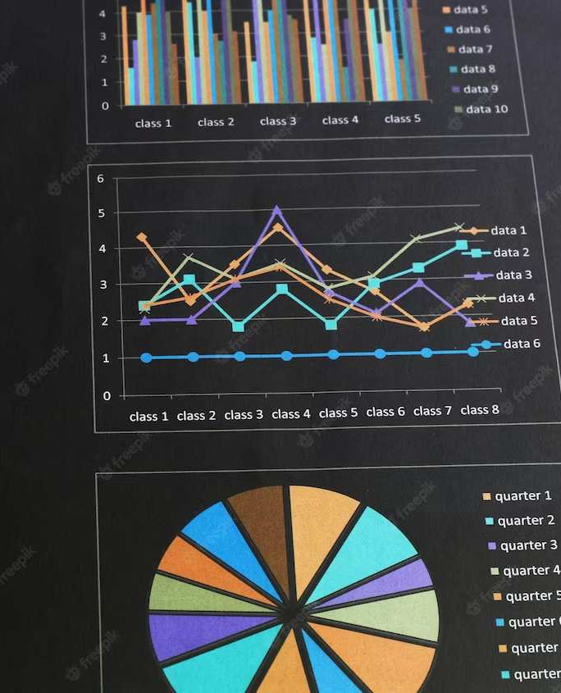
Methodology
The approach that has been suggested comprises of two primary stages:
sentiment categorization
topic ﬁnding

Slide 7

Dataset
The author has used 2 datasets for
training and evaluation:
Twitter data - Contains COVID-19- related tweets from Twitter.
Reddit data - Contains COVID-19-
related discussions from Reddit

Slide 8
Result
The SentiStrength algorithm was employed by the researchers to categorize COVID-19-related comments into positive, negative, or neutral sentiments. The percentages of comments that were classiﬁed as each sentiment were as follows:
Positive: 30.9%
Neutral: 41.6%
Negative: 27.5%

Slide 9

Challenges and Limitations
Limited Data Sources.
Focus on Speciﬁc Time Period. Single NLP Method

Slide 10

Future Directions
Replicate the study with a larger and more diverse dataset Investigate the use of other NLP methods for topic modeling and sentiment classiﬁcation
Explore the use of deep learning models for topic modeling and
sentiment classiﬁcation
Analyze the temporal evolution of
public sentiment and topics of discussion
Investigate the impact of public
sentiment and topics of discussion on public health outcomes

Slide 11
Conclusion
In summary, the utilization of NLP and LSTM recurrent neural networks has shed light on the prevailing sentiments and subjects explored in online discussions pertaining to COVID-19. By providing insightful information that can be utilized to inform public health strategies, crisis communication, and policy-making, this analysis enhances our comprehension of the pandemic's ramiﬁcations.

Slide 12
Thanks You!

